Slide 1
Welcome! The session will begin at 9am Eastern
About this session:
Ask questions in the chat
Please complete the survey
The speaker has no conflicts of interest associated with this talk
Links to the recording and slide deck will be emailed to registrants, usually within a week
Additional topics: https://its.weill.cornell.edu/scientific-computing-training-series
About CAC https://www.cac.cornell.edu/
The Center for Advanced Computing provides a broad range of services that support the computational research needs of Cornell faculty. The Center’s role is to enable and empower research capabilities and help Cornell’s scientists, researchers, and scholars achieve new and innovative breakthrough research. Our team provides expertise on high performance compute clusters, cloud computing through our Red Cloud service, and technology and application consulting tailored to individual research needs.

Slide 3
R Basics
Christopher Cameron
Computational Scientist
Cornell University Center for Advanced Computing
https://cac.cornell.edu/Cameron/
cjc73@cornell.edu

Slide 4
Today’s topics
Last semester, I focused on showcasing some of R’s best features.
Basic concepts needed to use R
How to install R and RStudio
The essential elements of the Rstudio interface
Loading and summarizing data
R takes time to learn, and this could be your first step. The materials and demonstrations today will help you get started.

Slide 5
R is…
Good for:
Less suitable for
tabular data (or vectors or lists)
statistical analysis
data visualization
Integrating custom code in C/C++, Fortran and Java.
unstructured data
file system scripting
data scraping, cleaning and formatting
Some people want R to do everything, so packages do exist to make some of these possible!
(Someone also wrote a web-crawler in SAS)

Slide 6
Motivation for R
What if we combine things we like into a statistical computing environment and make it free and open source so others could do the same?
Two faculty members at the University of Auckland wanted a “better software environment [for] their teaching laboratory” (1990s)
did not like the commercial offerings available
did like the S statistical programming language
wished S had some of the modern language features introduced in the Lisp variant called Scheme
R started as an S implementation with some Scheme features and was distributed via an email list
A colleague persuaded the authors to open-source R (1995)
Ihaka, Ross. (1998) R : Past and Future History, A Draft of a Paper for Interface ’98. https://cran.r-project.org/doc/html/interface98-paper/paper.html

Slide 7
Community
R is used and supported by a community of largely academic researchers and developers (and more recently, data scientists).
R gains new features via packages developed by the community
Over 10,000 add-on libraries!
R packages can target highly specialized research areas.
R packages are used to implement and share cutting edge statistical methodology.
The official package collection is at https://cran.r-project.org
Other collections exist: http://www.bioconductor.org.
Can load packages directly from github
Active community generating tutorials and demos:
https://www.r-bloggers.com
https://education.rstudio.com/learn/
https://cvw.cac.cornell.edu/R/
https://community.rstudio.com ← community help forum

Slide 8
Collective, eclectic development
R’s developers borrow code conventions and programming styles freely.
“object oriented” object.member naming is common but has no special meaning in R
Many conventions mixed together: InitalCaps, camelCase, snake_case, vars.with.dots (again, R does not assign special meaning)
Packages tend to work well with expected input and unpredictably with incorrect input.
Many ways to accomplish any given task, inspired by different paradigms.
Focus on practical, productive use
automatic and silent type conversion (casting)
convenience features can become gotchas (global namespace, attach)
packages can mask each other’s functions
variable names can have the same name as functions – mostly works, hard to read

Slide 9
Documentation
R has built-in help and documentation
A typical help entry includes
Descriptions of each function and their arguments.
Examples showing how the functions might be used.
References to relevant manuals and academic papers.
Documentation for packages usually also includes:
One or more vignettes demonstrating how the package can be used to perform an analysis.
Bundled data sets that support the vignette and demonstrate required data formats.

Slide 10
Mental model for using R
R has a workspace (or environment) that holds data tables and results.
Workspace is not particularly visible
These objects are held in the computer's memory
Objects in the workspace can be manipulated by R commands (functions)
You enter commands via the R console
to load data into the workspace (as an object)
to apply statistical functions to objects in the workspace
to produce or display output (most commands do not produce output!)
Most of the time, you are looking at commands describing what to do with the data and not at the data itself. (c.f. Excel)

Slide 11
R Concepts
Functions – This is the primary way to use R!
Function takes input and (probably) returns output.
Function input is one or more values called arguments
Calling a function is telling the function to operate on arguments.
Function name followed by arguments in parenthesis :
name(argument)
name(argument1, arg_name = argument2)
mean(column) # calculate mean of vector named “column”

Slide 12
R Concepts
Variables
Store and use values in the workspace
Variables are a name and associated value
Variable name represents the value in operations and function calls
Values or objects returned by function calls can be stored in variables
Create a variable by assigning a value to a name
Either <- or = are assignment operators in R
width = 20
width <- 20

Slide 13
R Concepts - Operators
Mathematical
+ addition
- subtraction
* multiplication
/ division
^ or ** exponentiation
x %% y modulus
x %/% y integer division
Logical Operators
!x not x
x || y x or y (returns TRUE or FALSE, use in if conditions)
x && y x and y (returns TRUE or FALSE, use in if conditions)
x | y x OR y (compares bitwise, so it potentially returns a vector)
x & y x AND y (compares bitwise, so it potentially returns a vector)
Comparison
< less than
<= less than or equal to
> greater than
>= greater than or equal to
== equals (comparison)
!= not equal

Slide 14
R Concepts
Working directory
R always has a working directory from which it tries to read/write files.
You can change the working directory if needed.
Files outside of working directory can be accessed via full file paths
Packages
collections of functions, data and documentation that add functionality to R.
Script files
Sequence of commands in plain text with a .R file extension.
Rmarkdown files
Narrative style markdown-based “R notebook” with .Rmd file extension.

Slide 15
R Concepts – Common Datatypes
Numeric: represents a numeric value (integer, float, double, etc)
3, 5.2, …
Boolean: logical values
TRUE, FALSE
Character: alphanumeric strings (text)
“cat”, “dog”, “a”
Factor: categorical variable
Gender, cohort, income brackets
Date[time]: Specific date or date and time
2023-02-14 9:00:00 EST

Slide 16
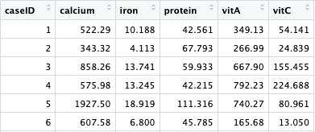
R Concepts – Data Frames
Data frame - a table-like arrangement of values in rows and columns.
Classic table of data structure like Excel or CSV files
Typically, rows are cases and columns are variables
All values in a column are same type, columns may be different types
data.frame (base R), data.table (large data), tibble (modernized data.frame)
Dataframe$ColumnName

Slide 17
R Concepts – Vectors
Vector - 1-dimensional array of values of the same type
Like a single column from a data frame
Created by the c() function:
my_vec = c(8, 6, 7, 5, 3, 0, 9)
my_names = c("caseID”, "calcium”, "iron”)
Indexed by position, starting with 1:
my_vec[1] is 8
my_vec[7] is 9
my_vec[1:4] is c(8, 6, 7, 5)

Slide 18
R Concepts – List
List - a collection of mixed types, optionally with names
Statistical functions tend to return results in list-like formats
Created by the list() function:
my_list2 = list( message = "I like R", yesterday = as.Date("2023-02-13"), width = 20)
Retrieve by position, starting with 1:
my_list2[[1]] is "I like R”
Retrieve by name, if named (preferred):
my_list2$message is "I like R”
names(my_list2) is c("message”, "yesterday”, "width”)

Slide 19
R Concepts – Other data containers
a stack of values → vector
a stack of vectors with same data type → matrix
a stack of matrices with same data type → multidimensional array

Slide 20
Base R
The R Project for Statistical Computing is maintained by The R Foundation.
free and runs on Linux, Windows and MacOS.
https://www.r-project.org
Command line interface via R console
Creates objects in memory rather than printing to screen
You query and manipulate these in-memory objects
Interactive, but not in the point-and-click GUI sense.
Many people that “use R” do not use it directly. Instead, they use something that interfaces with the R environment.
RStudio IDE
Jupyter Lab notebooks
Google CoLab

Slide 21
Installing R
R is distributed via the Comprehensive R Archive Network (CRAN) which is mirrored by universities and other institutions around the world.
choose a mirror: when installing R and packages from CRAN, the first step is to “choose a mirror”. Choose an institution close to you.
https://cloud.r-project.org is a “mirror” that automatically redirects you to a nearby mirror when installing R.

Slide 22
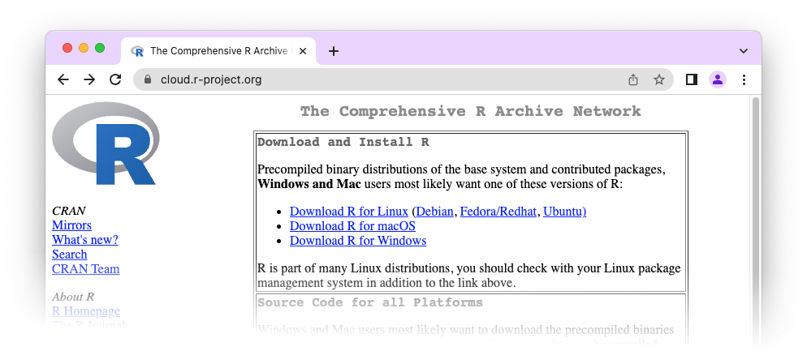
Downloading R https://cloud.r-project.org

Slide 23
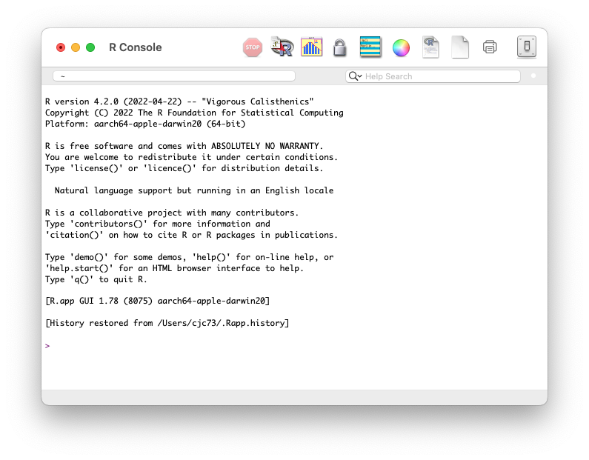
R Console

Slide 24
RStudio
RStudio is an integrated development environment for R
developed by RStudio Public Benefit Corporation (now Posit)
depends on installed R version
adds useful development, analysis and authoring features
RStudio interface incorporates the R Console
Posit will incorporate Python compatibility
Tip: If you want to install RStudio locally, install R and then install RStudio
RStudio Cloud (soon to be Posit Cloud) https://rstudio.cloud is a hosted version of RStudio with the same interface as the desktop application.

Slide 25
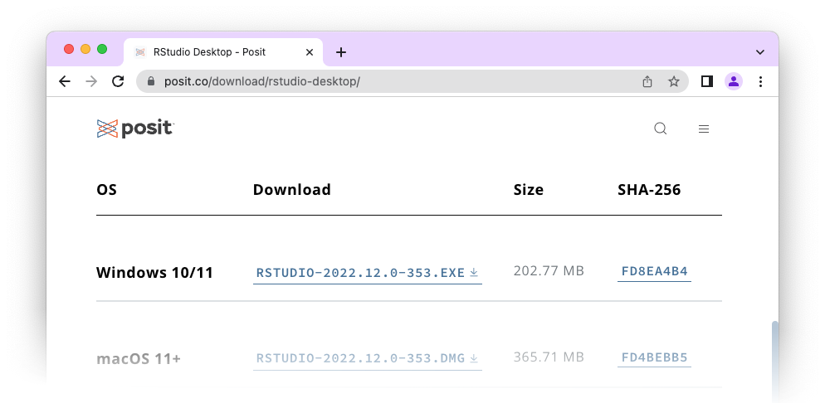
Downloading Rstudio https://posit.co/download/rstudio-desktop/
Scroll down

Slide 26
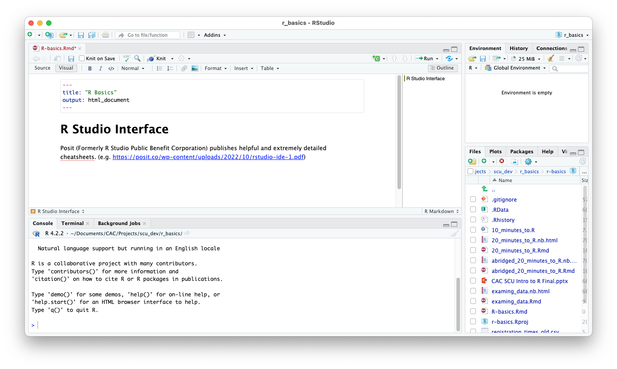
RStudio Interface

Slide 27
RStudio Interface – Resizable Panes

Slide 28
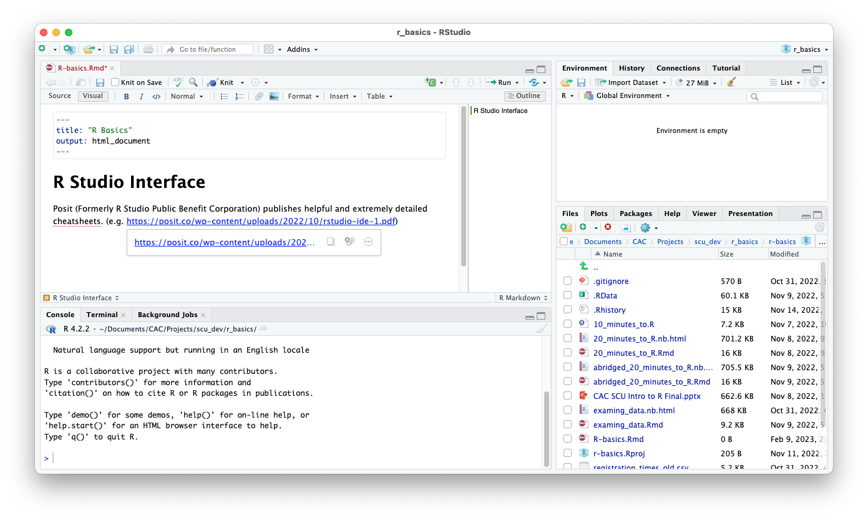
RStudio Interface - Resized

Slide 29
RStudio Interface
Upper Tab pane
Editor
Lower Tab pane
R Console

Slide 30
R Console
Type and run commands
View output
Up/Down arrows to navigate command history
Good for:
Exploratory commands
Testing commands
Bad for:
Documenting analysis
Repeatable analysis

Slide 31
R Editor
Write scripts. (.R)
Create Rmarkdown documents (.Rmd)
Limited data viewer
Good for:
Documenting analysis
Repeatable analysis
For most people, writing the commands in the editor is the best workflow
Execute script commands in Console
Execute commands within Rmarkdown documents

Slide 32
RStudio Tab Panes
Upper:
Workspace / Environment Viewer
Data import wizard
Command history
Tutorials
Lower:
File browser
Package Manager
Help
Plots

Slide 33
Packages
Many packages from many disciplines → many ways to accomplish most tasks
No need to be an R “purist”
Packages were created to streamline common operations

Slide 34
Tidyverse https://tidyverse.tidyverse.org
install.packages("tidyverse”, dependencies=TRUE)
library(tidyverse) will load the core tidyverse packages:
ggplot2, for data visualization
Dplyr, for data manipulation, merging
Tidyr, for data tidying
Readr, for data import
Purrr, for functional programming
Tibble, a modern replacement for data frames
stringr, for strings
forcats, for factors

Slide 35
More information
Cornell Virtual Workshop in R: https://cvw.cac.cornell.edu/R/
CVW offers free self-paced, text-based modules covering a variety of computational focused topics. The CVW R topic complements today’s workshop and covers using R on multiple cores and on supercomputer infrastructure.
RStudio Cheatsheets:
https://www.rstudio.com/resources/cheatsheets/
Thoughtfully designed, single-page, double-sided reference sheets for major R packages.

Slide 36
More information
Using R for teaching and research:
https://www.chrisbail.net/teaching
Chris Bail’s work is a good example of incorporating R into teaching and research at undergraduate and graduate levels. Dr. Bail uses R for most aspects of his data collection and analysis.
eBooks:
R for Data Science, Hadley Wickam and Garrett Grolemund - https://r4ds.had.co.nz
Advanced R (Programming), Hadley Wickam - https://adv-r.hadley.nz

Slide 37
More information
Installing R for Jupyter Notebooks:
If you already use Jupyter, you can install the R jupyter kernel to use R in the familiar notebook environment. If you are on macOS, read the yellow warning box on the linked page. https://irkernel.github.io/installation/
R packages on CRAN by area:
https://cran.r-project.org/web/views/

Slide 38
Thank you for attending!
Please complete the survey
Links to the recording and slide deck will be emailed to registrants, usually within a week
Additional topics: https://its.weill.cornell.edu/scientific-computing-training-series

